Slide 1
Method of Hyperparameter Optimization of a Genetic Algorithm applied in Critical Scenario Generation for Autonomous Vehicles Master‘s Thesis Presentation

Slide 2
Introduction
Method for critical traffic scenario generation
Can be used to validate safety of autonomous driving systems
Implementation:
Autonomous driving functionality is applied on the EGO vehicle
Genetic Algorithm optimizes the criticality of the traffic scenario
Controls all other vehicles and pedestrians (NPCs) in the simulation
The Cumulated Emergency Brake Duration of the EGO vehicle serves as the criticality measure

Slide 3
Research Questions
Q1: Is a genetic algorithm suitable for generating critical driving scenarios compared to random search?
Q2: Can the performance of a genetic algorithm be improved by optimizing the control parameter using the Taguchi method?

Slide 4
Simulation Setup
Traffic Manger provides a traffic simulation
Vehicles and pedestrians move through the simulation in a realistic manner
Provides an interface to alter individual actor behaviour through actions
Example actions: LaneChange, JunctionSelection, ModifyTargetVelocity, CrossRoad, etc …
Genetic Algorithm optimizes the fitness function by directing NPCs through actions
Traffic Manger
Genetic Algorithm
Fitness
Action Interface
NPC 1
NPC 2
NPC 3
…

Slide 5
Genetic Algorithm Overview
Search algorithm inspired by the process of natural selection
Can efficiently navigate large search spaces
Population-Based Optimization:
Operates on a population of individuals
Individuals evolve over multiple generations
Fitness function guides the selection of better individuals
Chosen individuals reproduce using crossover and mutation operations
One individual consist of one chromosome
One chromosome describes one solution to the search problem
Usually needs a custom encoding to fit a search problem
Two different encoding were designed to contain the actions for all NPCs for a whole simulation
Consist of a list of genes

Slide 6
Genetic Algorithm - Crossover Comparison
Two Point Crossover
0
1
2
3
4
5
6
7
8
9
10
11
12
13
14
15
16
17
18
19
0
1
2
3
4
5
6
7
8
9
10
11
12
13
14
15
16
17
18
19
+ Keeps sequences mostly intact
- Might struggle to maintain diversity

Slide 7
Genetic Algorithm - Crossover Comparison
50% Uniform Crossover
0
1
2
3
4
5
6
7
8
9
10
11
12
13
14
15
16
17
18
19
0
1
2
3
4
5
6
7
8
9
10
11
12
13
14
15
16
17
18
19
+ Keeps diversity high
- Disruptive to sequences

Slide 8
Hyperparameter Tuning
Literature review
Recommended hyperparameter combinations gathered from existing literature
32 different hyperparameter combinations tested over 5 repetitions
Taguchi Method
Developed by Genichi Taguchi for robust optimization
Part of Design of Experiment
Systematic approach for process optimization
Identifies factors (i.e., hyperparameters) impacting performance
Identifies optimal factor-level (i.e., setting for each hyperparameter) combination
Advantages of Taguchi Method:
Minimizes number of experiment runs
Simplicity
Allows the investigation of predefined interactions between factors

Slide 9
Hyperparameter Tuning – Taguchi Method
Required 16 experiment runs, to optimize
Three 4-level factors
Four 2-level factors
and investigate one interaction
Each run was repeated 8 times
Results showed these hyperparameter to be most significant
Selection Method
Crossover Type
Mutation Probability
Notes:
Three hyperparameters, each having 4 possible settings

Slide 10
Genetic Algorithms Comparison
Hyperparameter Combinations
Settings | Literature Review | Taguchi Method
Number of Generations | 30 | 30
Population Size | 96 | 96
Crossover Type | Two Point | Uniform 50%
Crossover Probability | 80% | 90%
Mutation Probability | 20% | 30%

Slide 11
Evaluation
Comparison between:
Optimized Genetic Algorithm – uses the resulting settings from the Taguchi method
Default Genetic Algorithm – uses best settings from the literature review
Random Search
Each algorithm was tested on
4 different start scenarios
Each experiment repeated 10 times

Slide 12
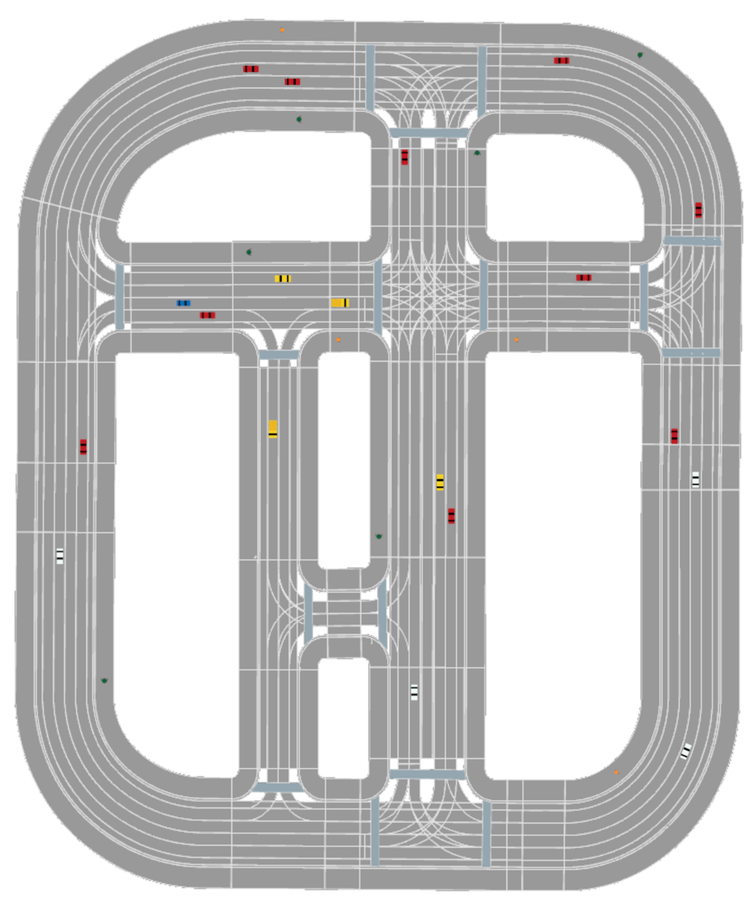
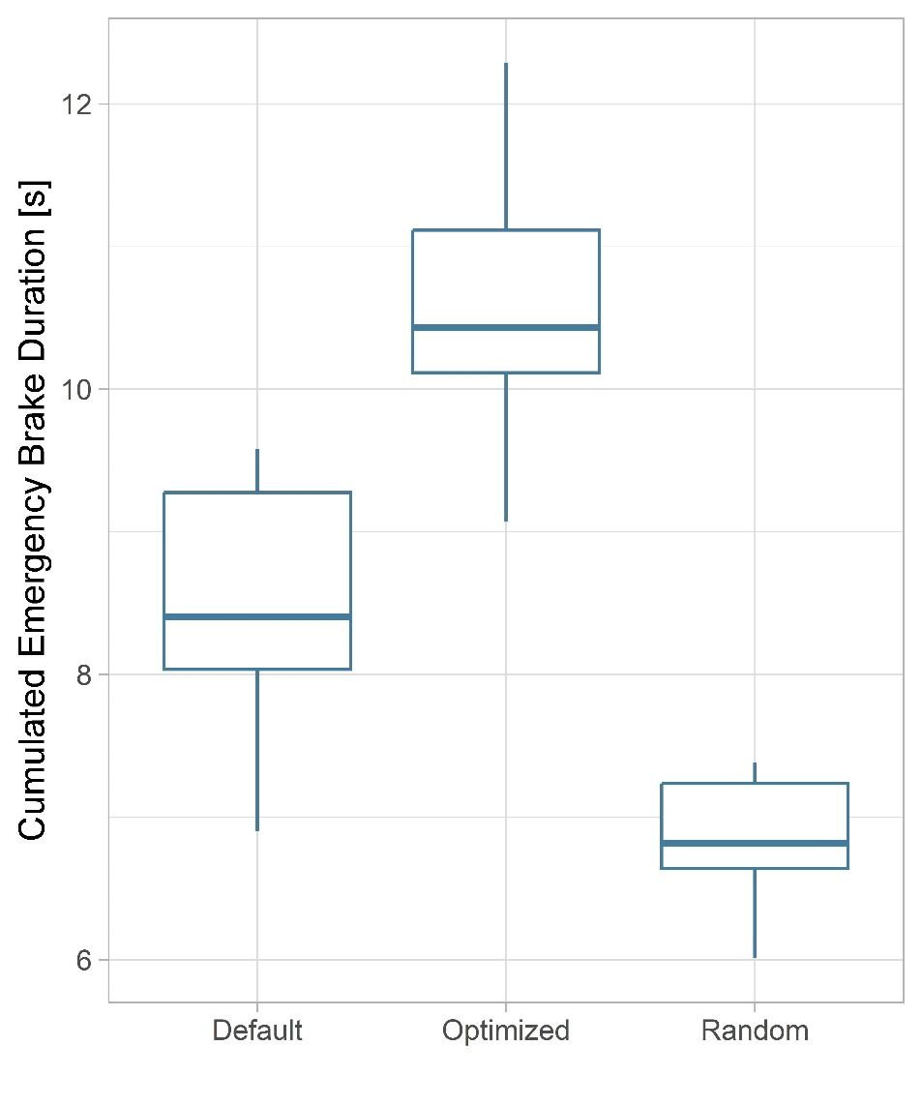
Evaluation: Start Scenario 1
Notes:
Better text, better graphs

Slide 13
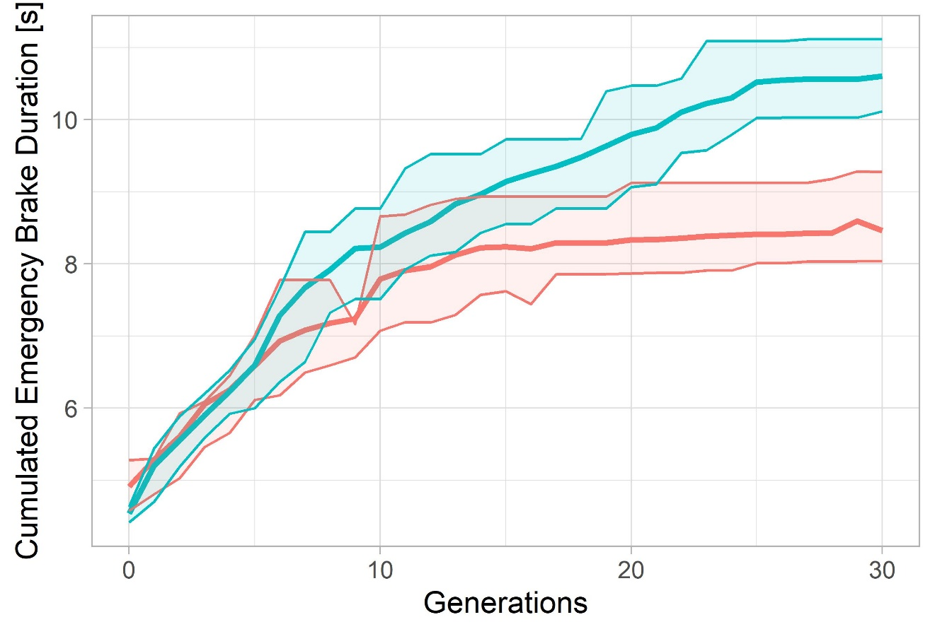
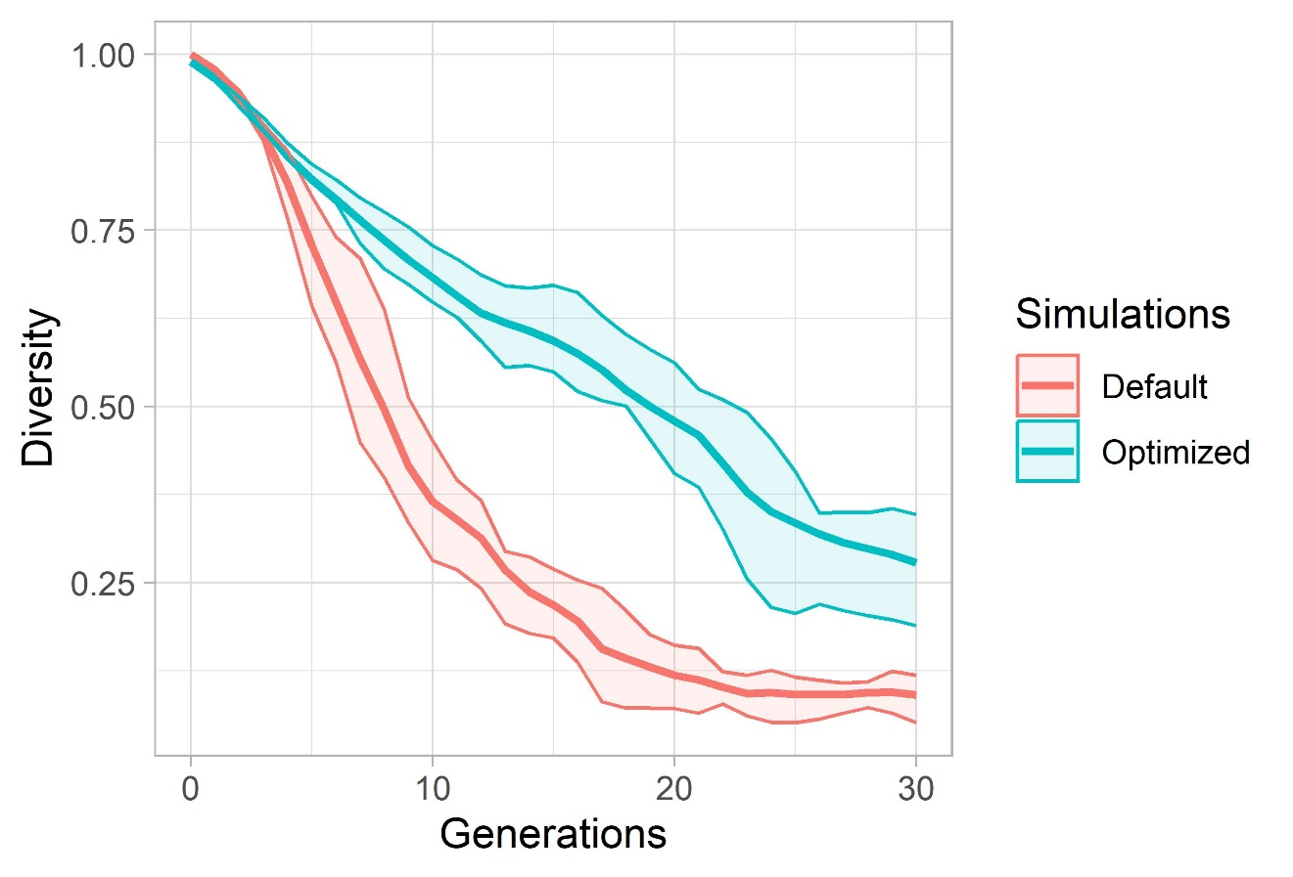
Evaluation: Start Scenario 1
Notes:
TODO: Better text, better graphs

Slide 14
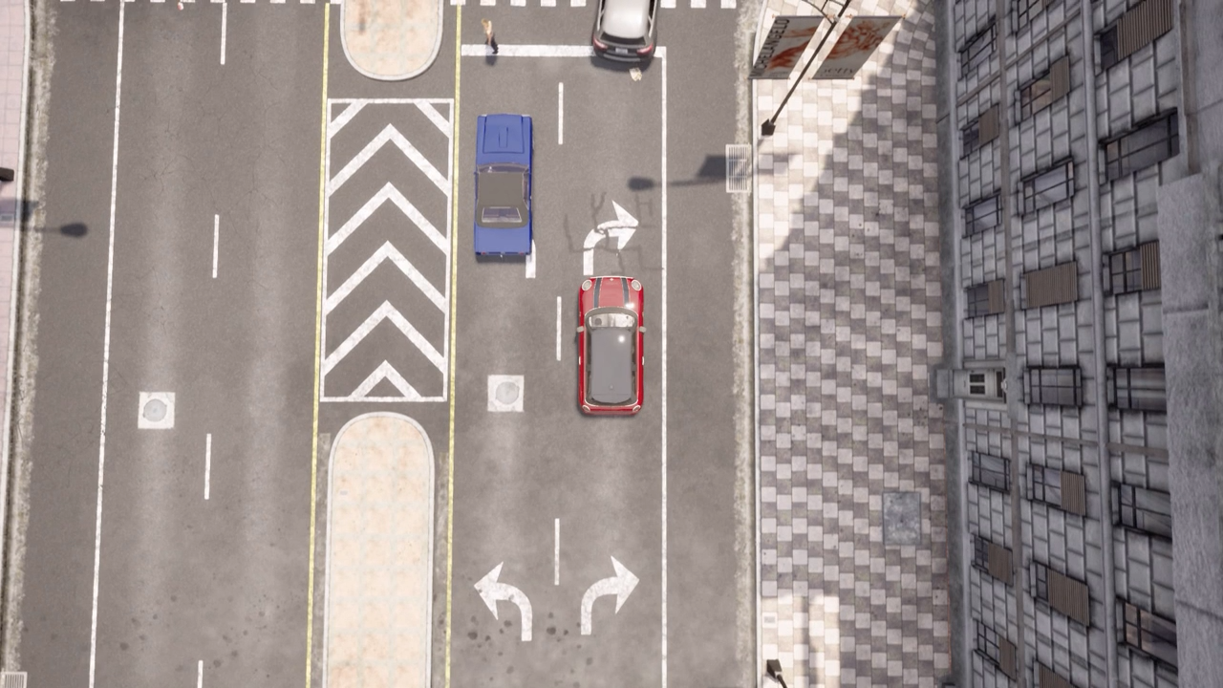
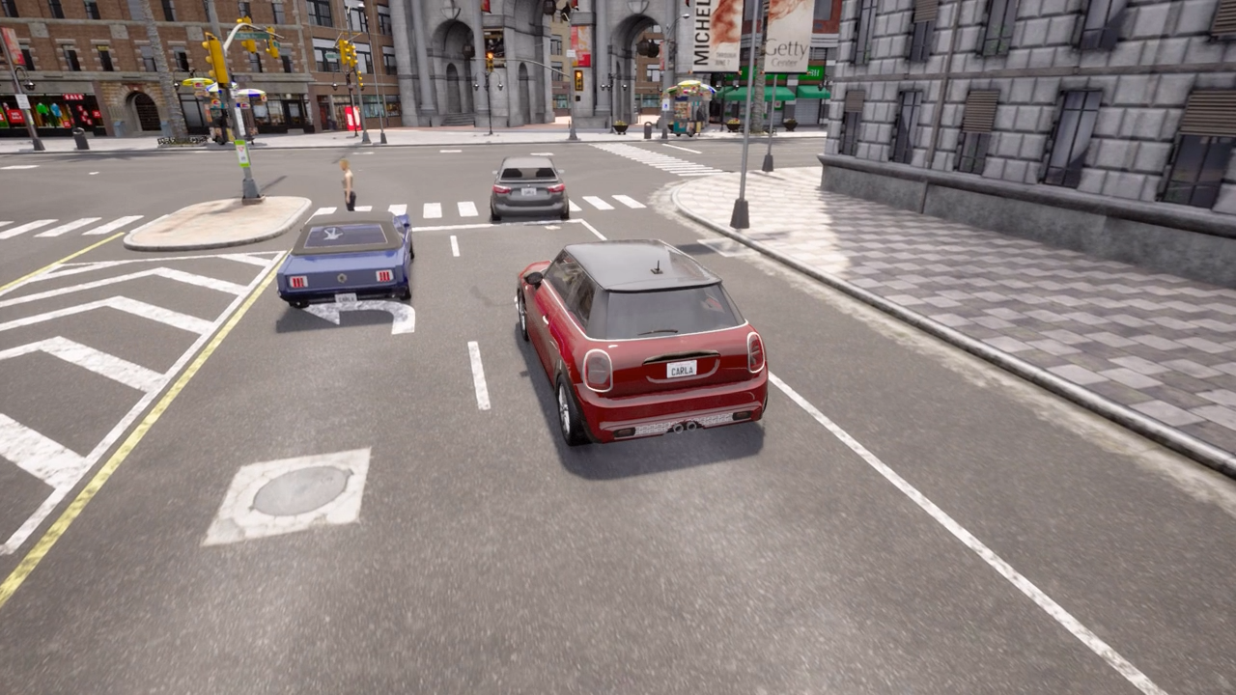
Critical Situation 1
Critical Situation after pedestrian crossing
NPC vehicle violates path of EGO vehicle
EGO vehicle has to emergency break

Slide 15
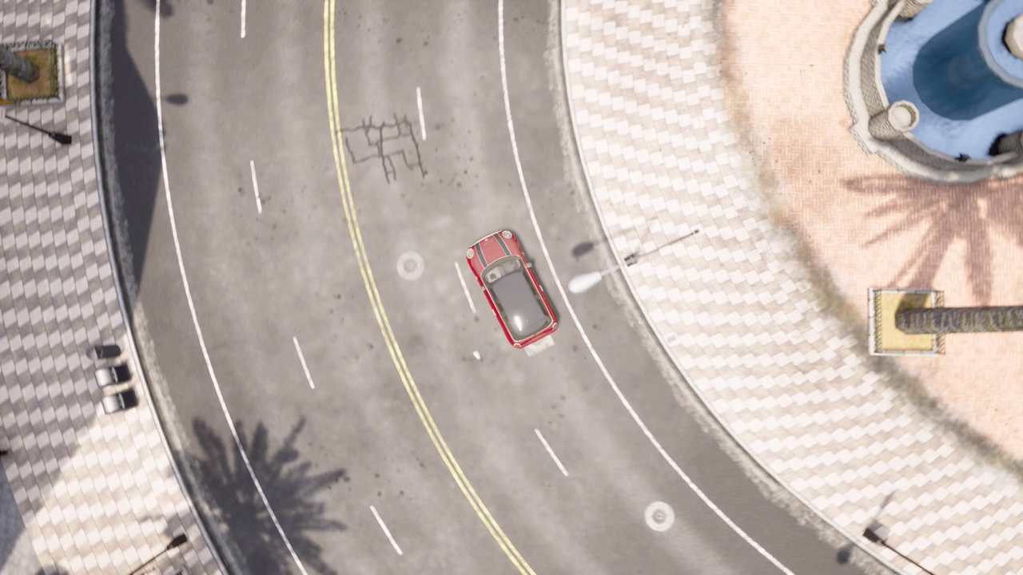

Critical Situation 2
Critical Situation inside junction
NPC vehicle ignores right of way
EGO vehicle has to emergency break

Slide 16


Critical Situation 3
Kid is occluded by Truck and runs over road
EGO vehicle has to emergency break

Slide 17
Thank You!

Slide 18
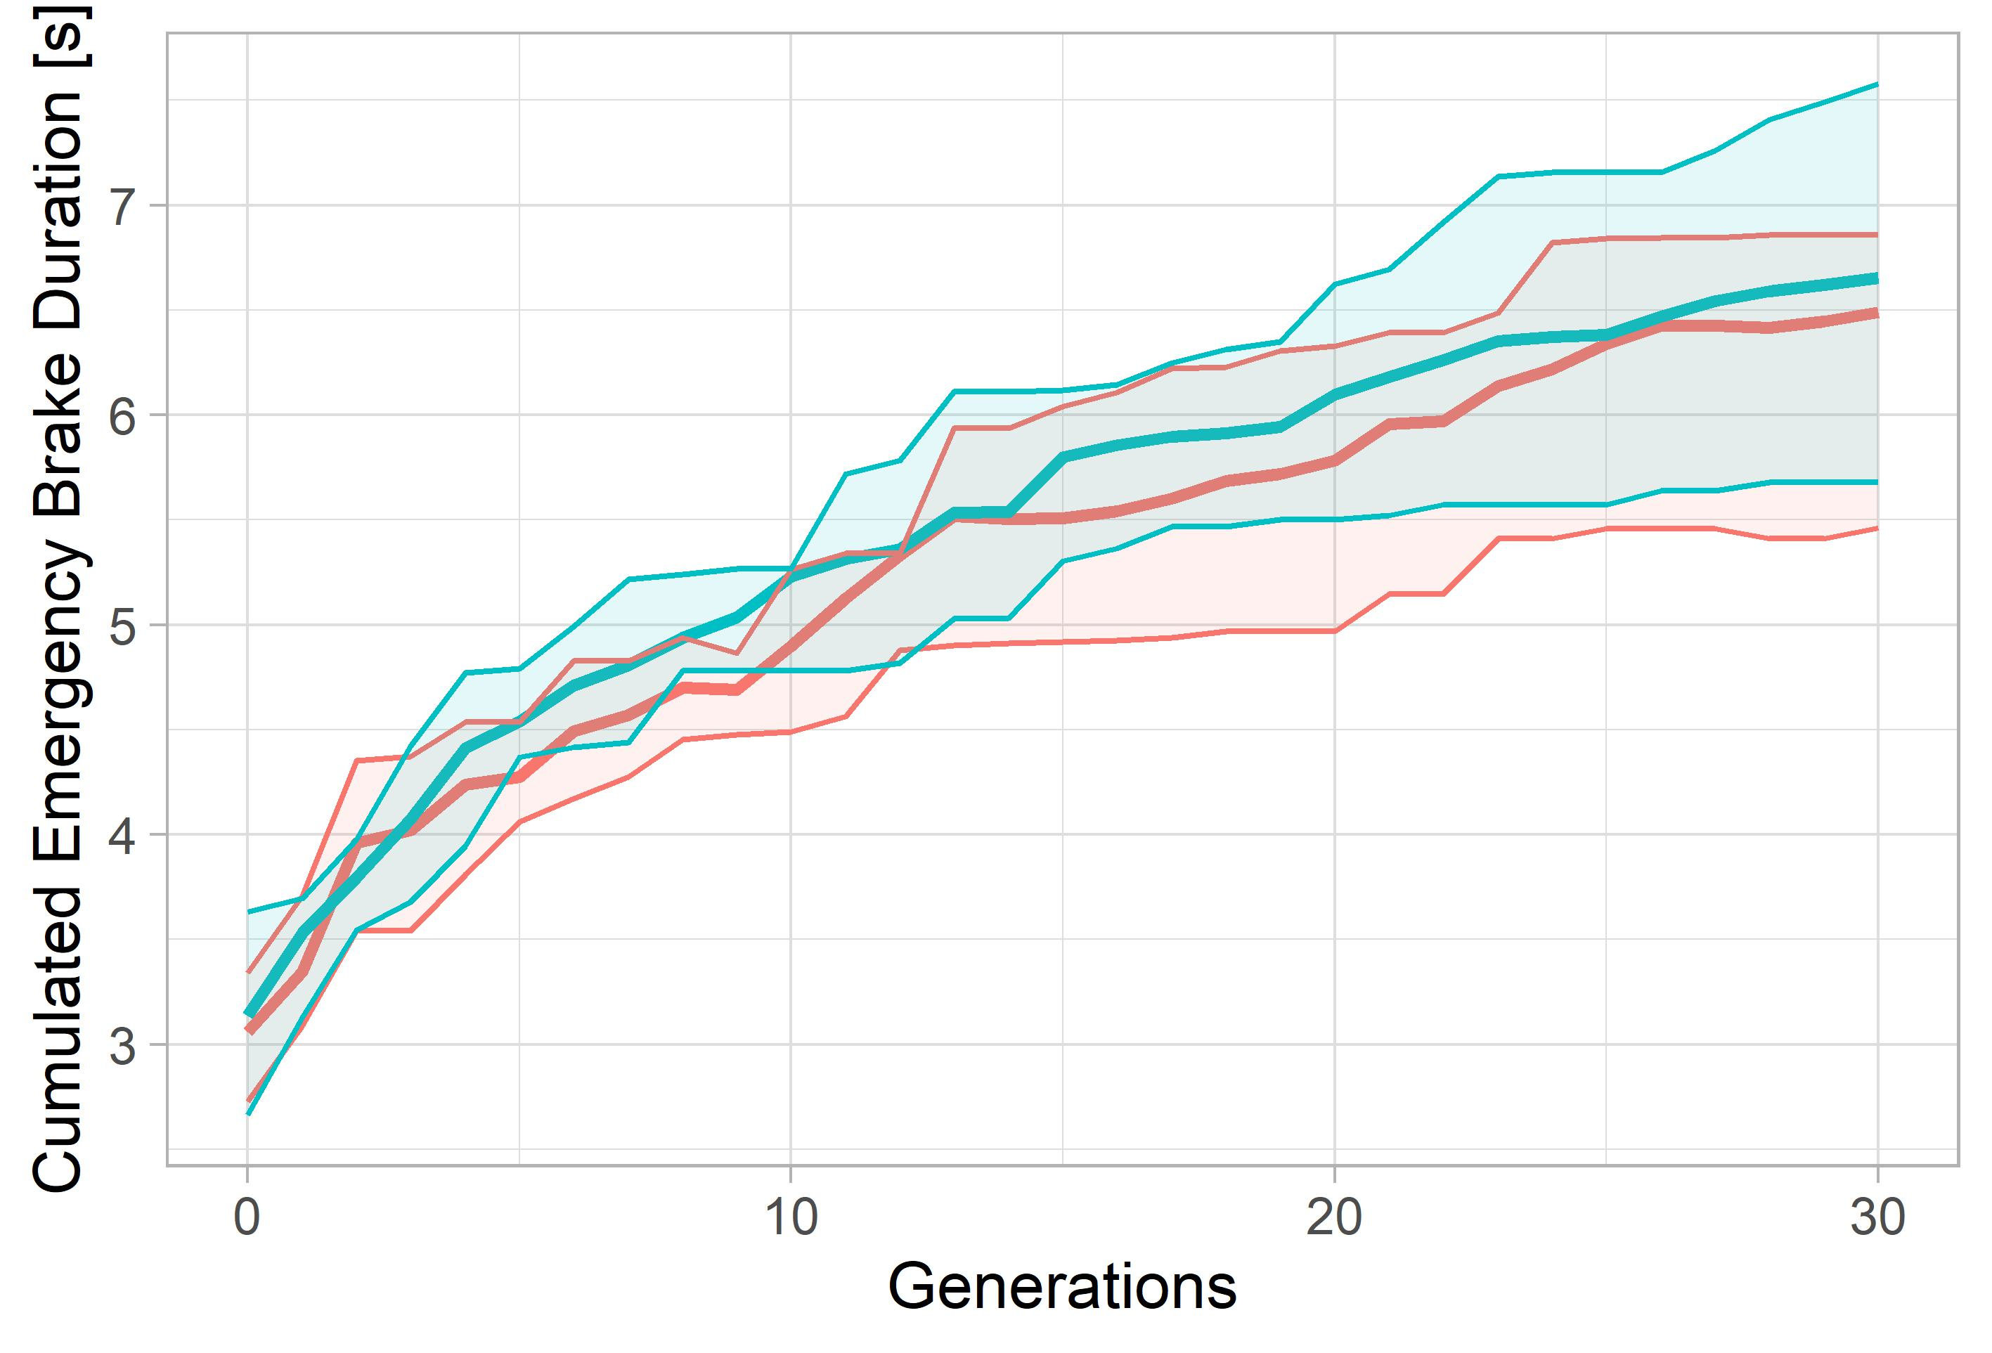
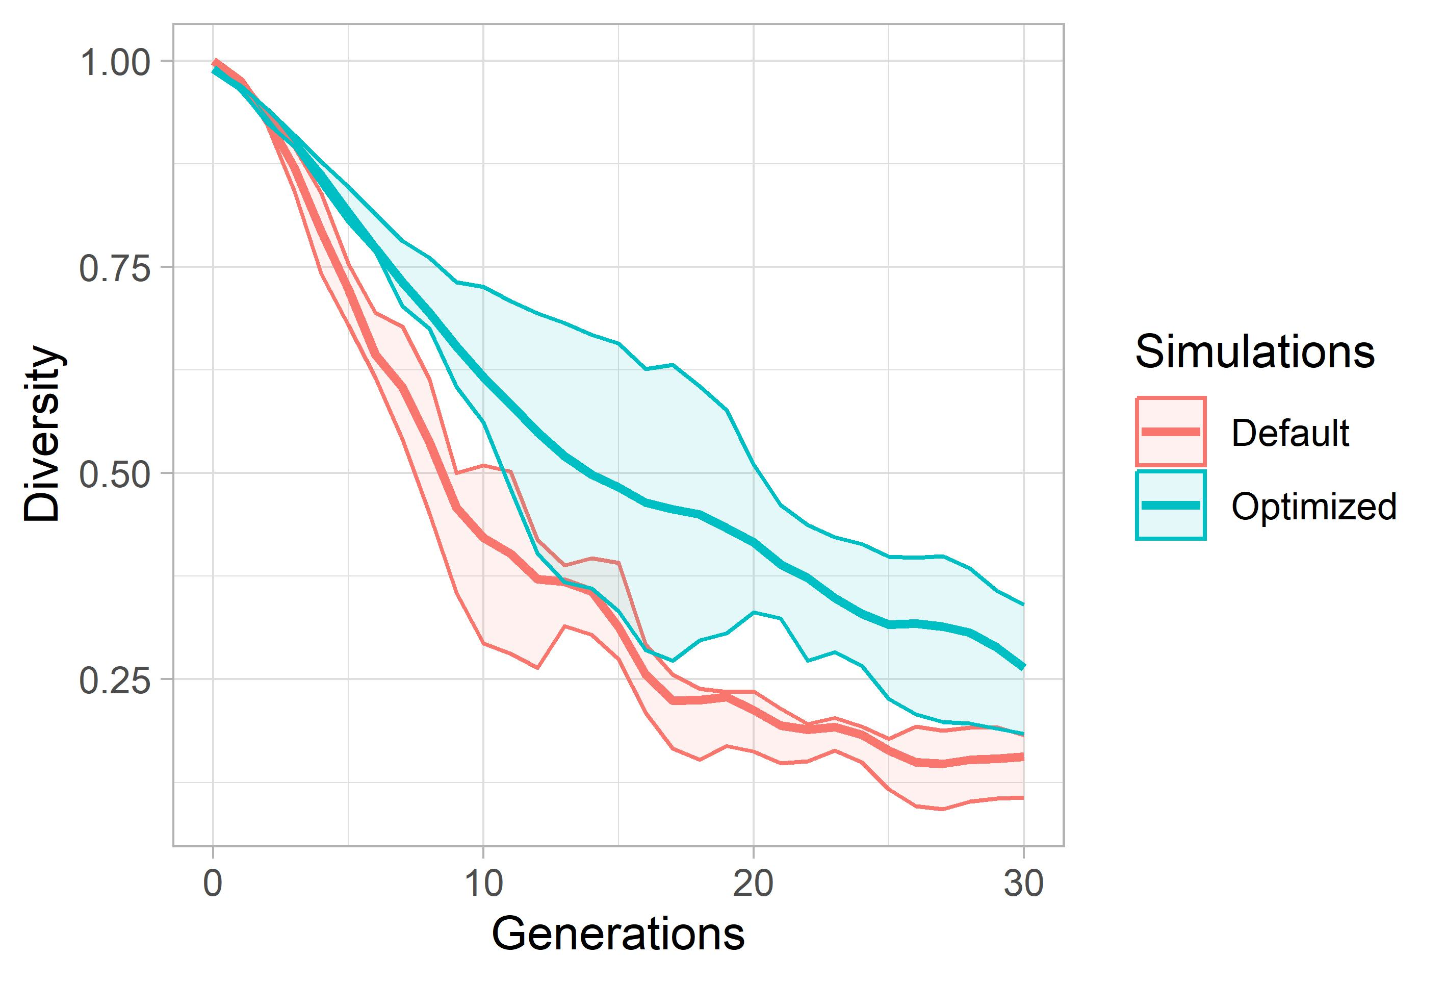
Evaluation: Start Scenario 2

Slide 19
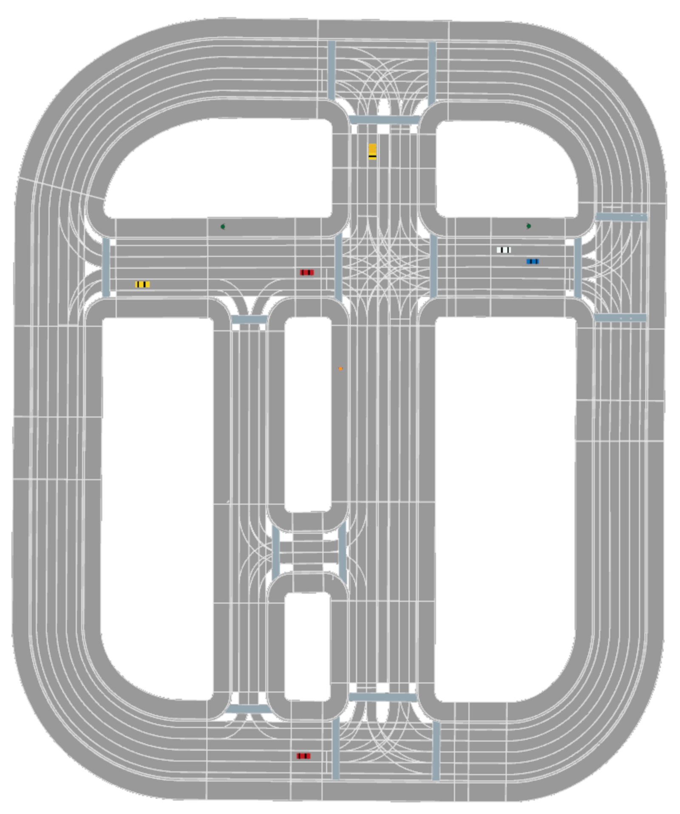
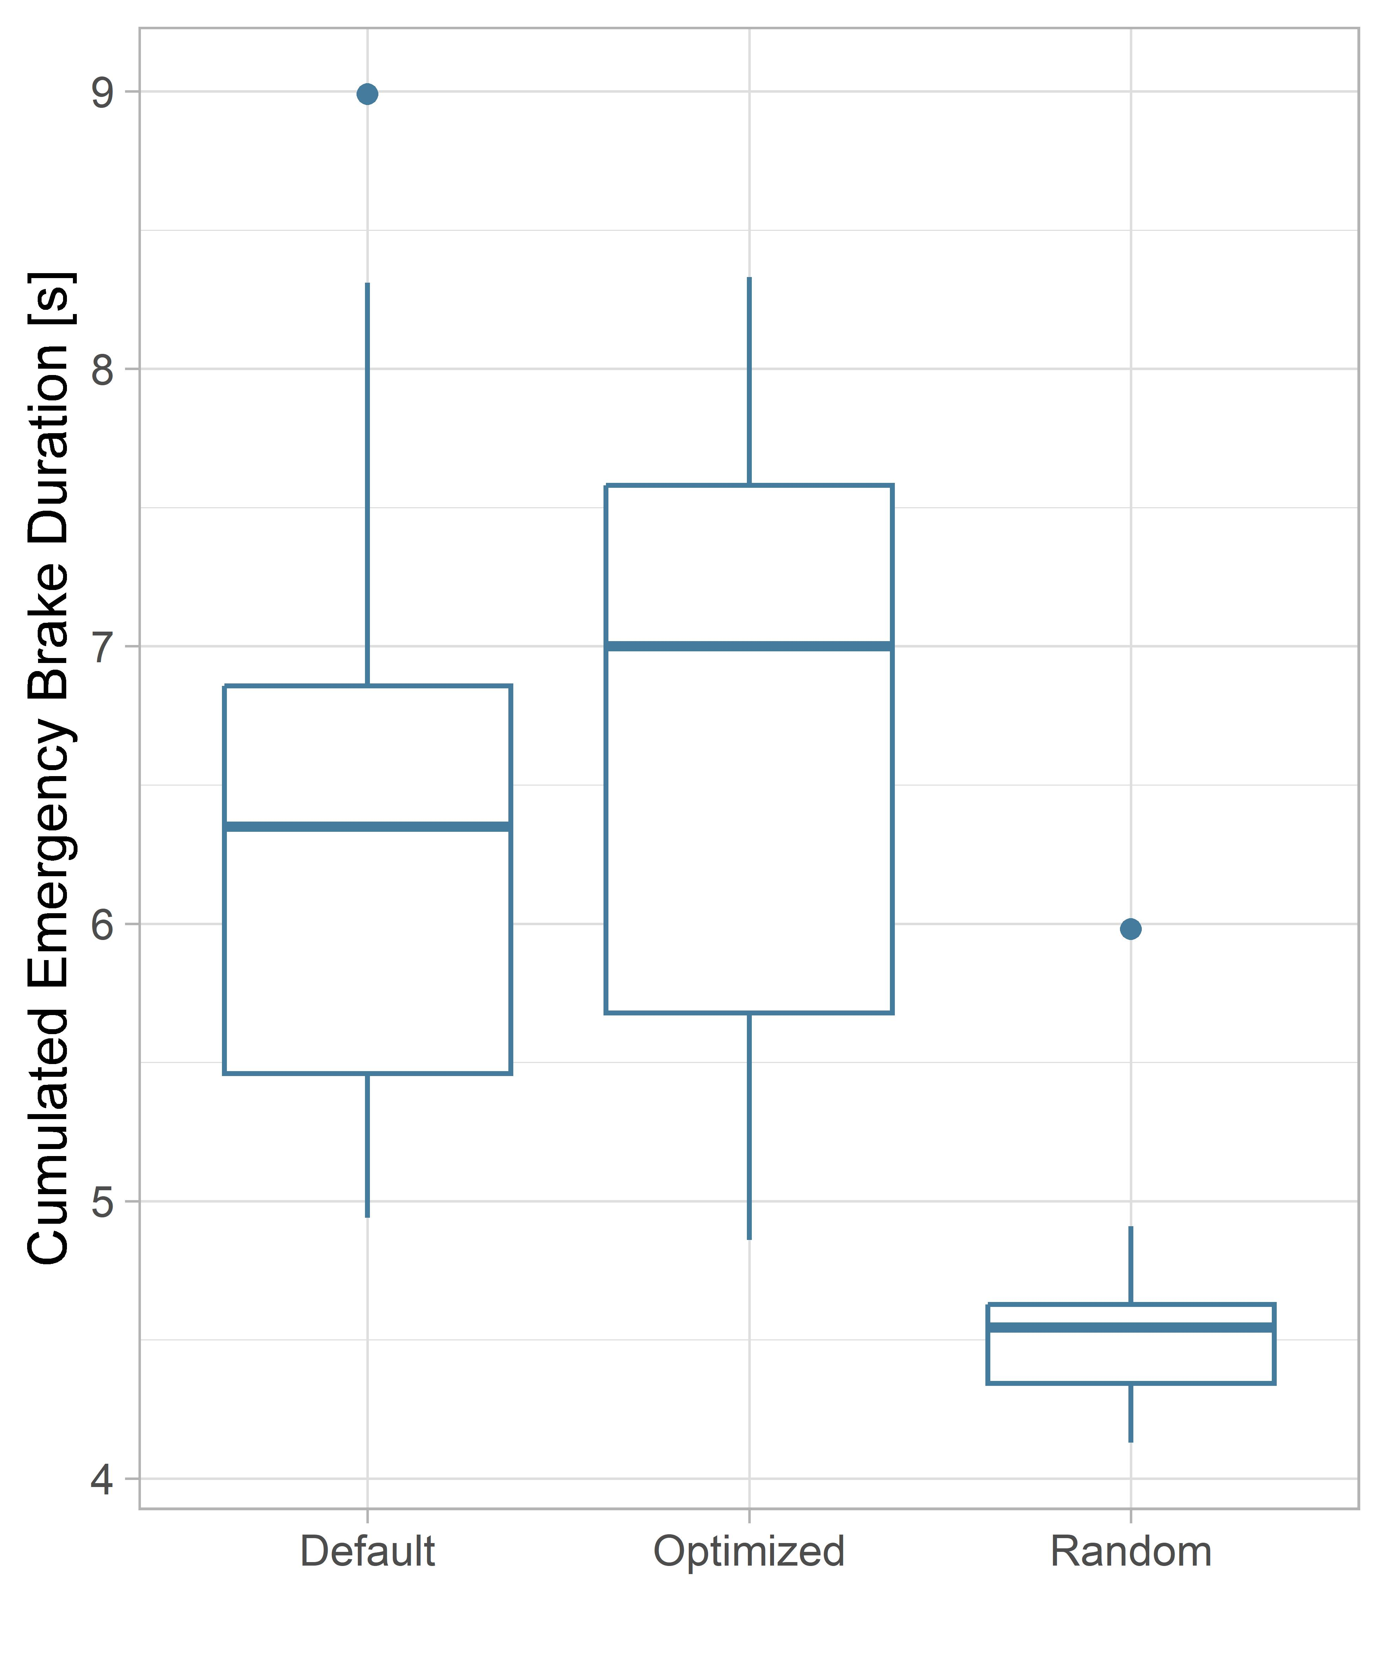
Evaluation: Start Scenario 2

